Slide 1
Name : Navyaan Patel Title : Final Year Project Presentation Project Name : Sentiment Analysis Coordinator: Sir Saad Ahmed

Slide 2
What is Sentiment Analysis? Sentiment analysis is the process of analyzing digital text to determine if the emotional tone of the message is positive, negative, or neutral. Today, companies have large volumes of text data like emails, customer support chat transcripts, social media comments, and reviews. Sentiment analysis tools can scan this text to automatically determine the author’s attitude towards a topic. Companies use the insights from sentiment analysis to improve customer service and increase brand reputation.

Slide 3
Use Case:

Slide 4
Flow Chart

Slide 5
Why is Sentiment Analysis Important? Sentiment analysis, also known as opinion mining, is an important business intelligence tool that helps companies improve their products and services. We give some benefits of sentiment analysis below. Build better products and services A sentiment analysis system helps companies improve their products and services based on genuine and specific customer feedback. AI technologies identify real-world objects or situations (called entities) that customers associate with negative sentiment. From the above example, product engineers focus on improving the processor's heat management capability because the text analysis software associated disappointed (negative) with processor (entity) and heats up (entity).

Slide 6
Analyze at scale Businesses constantly mine information from a vast amount of unstructured data, such as emails, catboat, transcripts, surveys, customer relationship management records, and product feedback. Cloud-based sentiment analysis tools allow businesses to scale the process of uncovering customer emotions in textual data at an affordable cost. Real-time results Businesses must be quick to respond to potential crises or market trends in today's fast-changing landscape. Marketers rely on sentiment analysis software to learn what customers feel about the company's brand, products, and services in real time and take immediate actions based on their findings. They can configure the software to send alerts when negative sentiments are detected for specific keywords.

Slide 7
How does sentiment analysis work? Text Preprocessing: The first step in sentiment analysis is to preprocess the text data. This involves tasks such as removing punctuation, converting text to lowercase, and tokenizing the text into words or phrases. Stop words (common words like "the," "and," "in") are often removed because they don't carry significant sentiment information. Feature Extraction: Sentiment analysis relies on extracting features from the text that can help determine sentiment. Common features include: Bag of Words (BoW): Creating a vocabulary of words in the text and representing each document as a vector of word counts.

Slide 8
Sentiment Classification: Once the text data is preprocessed and features are extracted, a machine learning model or a rule-based system is used to classify the sentiment. Common classification approaches include: Binary Classification: Determining whether the sentiment is positive or negative. Multi-class Classification: Identifying specific emotions like joy, anger, sadness, etc. Model Evaluation: After training, the model is evaluated using a separate dataset to assess its performance in predicting sentiment accurately. Common evaluation metrics include accuracy. Inference: Once the model is trained and evaluated, it can be used to analyze the sentiment of new, unseen text data.

Slide 9
Datasets:
The datasets I used is NLP dataset with the following link
https://www.kaggle.com/datasets/praveengovi/emotions-dataset-for-nlp

Slide 10
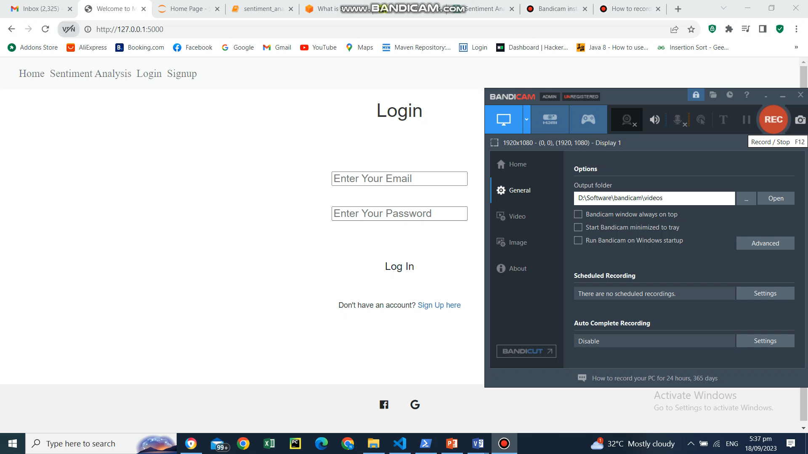
Recording
`

